Slide 1
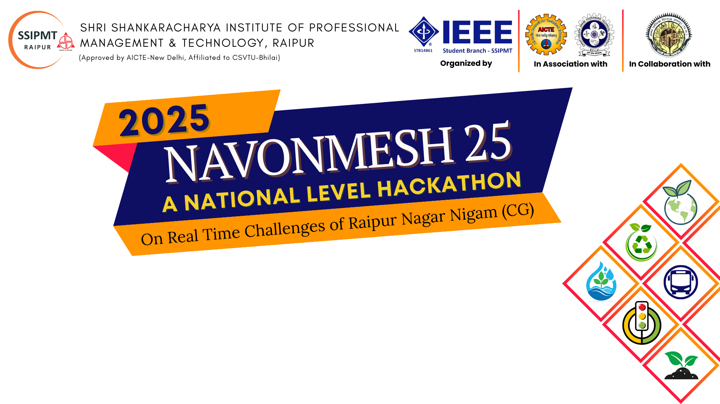
TEAM NAME : Code bringers
THEME : Water bodies and river conservation
PS CATEGORY : Software & Hardware

Slide 2

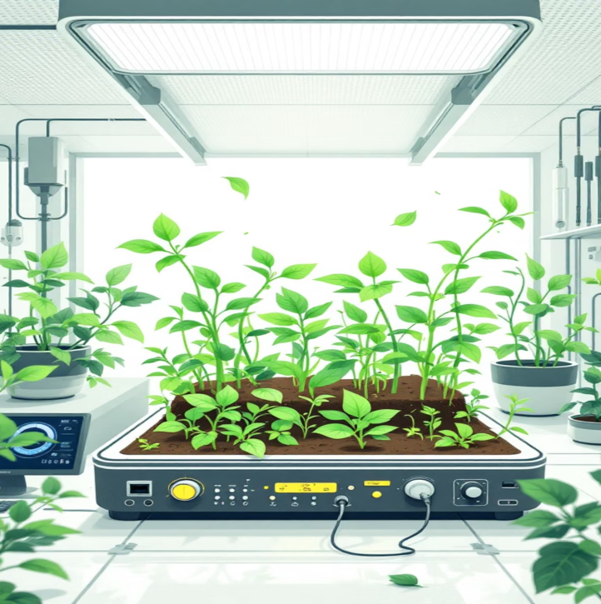
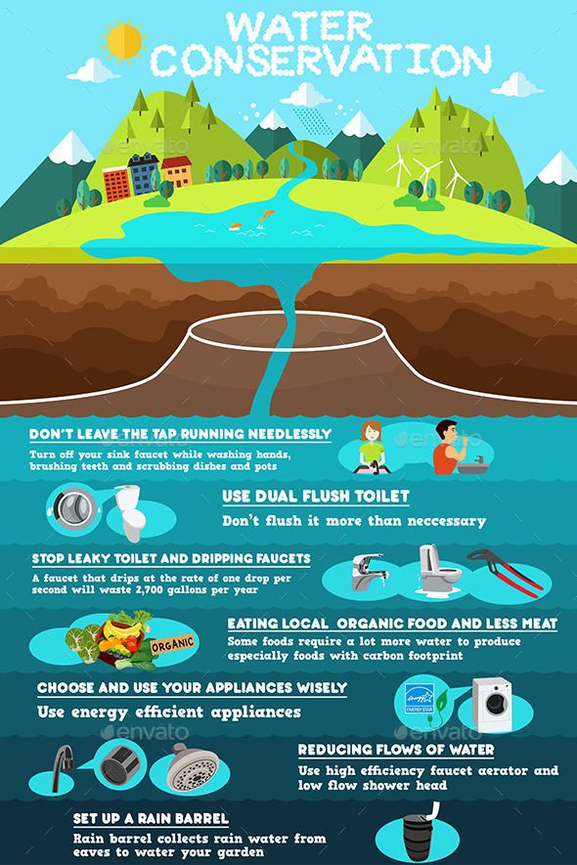
IDEA TITLE
Water Bodies and River Conservation
Our Solution
Water bodies are natural or artificial collections of
water , such as rivers, lakes , ponds , wetlands,
reservoirs and oceans, which are essential for life ,
biodiversity, agriculture, industry, and climate
regulation. River conservation is a focused set of
activities and policies aimed at protecting ,
restoring , and maintaining rivers and their
ecosystems, ensuring they remain healthy and
sustainable for present and future generations.
E - Soil
Real time prediction
- E- soil (electronic soil).
- Detecting the water & soil quality. .
- intelligent dashboard.
- It is use backend, frontend ,
Database, etc. .
- Water conservation.
- Urban agriculture.
- Sustainable materials.
- Feeding a growing population
sustainable
Page 1

Slide 3

TECHNICAL APPROACH
Technology stack
Frontend : Html , JavaScript ,CSS .
Backend : python, Node .j s , Flask , Advance AI/ML.
Database : Mongo DB , SQL.
Hardware : Hardware tools .
Key point
Model train for data sheet.
Real time detection.
Page 2

Slide 4
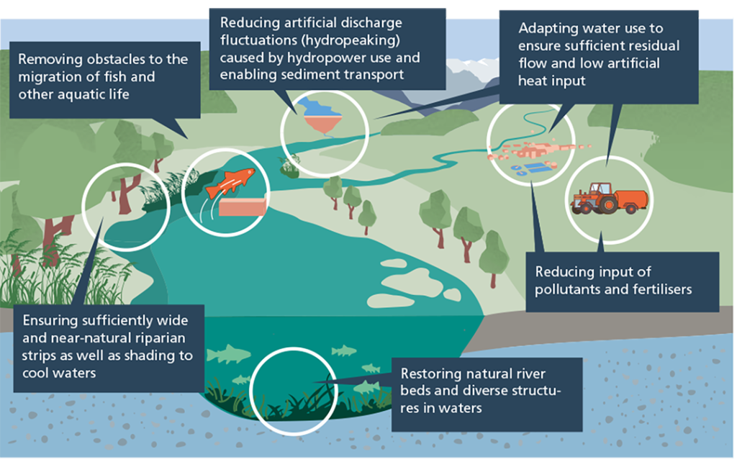

FEASIBILITY AND VIABILITY
The project solution E-soil is developing technique which can very expensive.
Detecting the water and soil quality- what kind of element are present in water & soil , & it is hamrful or not.
The properties are which are good for water & soli and which are bad for water and soil.
In order to make project more accurate it requires the precise detailing of element.
Page 3

Slide 5
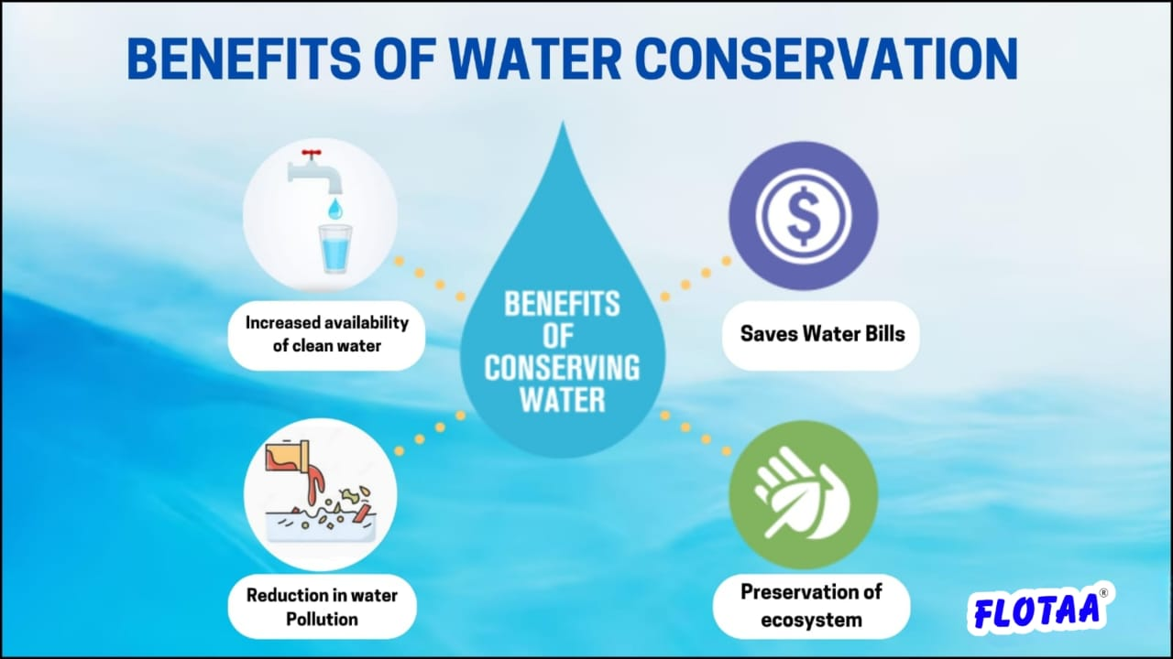
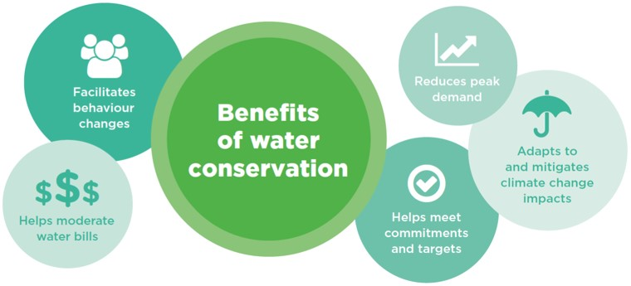

IMPACT AND BENEFITS
It help farmer to boost their crop production.
It help government to clean rivers.
The project gives clear knowledge about quality of water.
It specify the element which is higher & lower then normal limit.
It tells uses to add element which is lacked in water.
Page 4

Slide 6
RESEARCH AND REFERENCES
References
A Non-Invasive Soil Moisture Sensing System Electronic Architecture :- Explores the electronic architecture and feasibility of non-invasive soil moisture detection, directly supporting the 'E-Soil' concept. https://www.mdpi.com/1424-8220/20/21/614
Advancements in dielectric soil moisture sensor Calibration :- A comprehensive review of the methods and techniques required for accurate dielectric soil moisture sensors, crucial for data accuracy. Link-https://www.ars.usda.gov/research/publications/publication/?seqNo115=406421
IOT BASED WATER AND SOIL QUALITY MONITORING SYSTEM :-Details the use of multiple sensors (pH, EC, Moisture) and IOT/Cloud technologies for real-time monitoring, relevant to your Technical Approach . link –https://www.semanticscholar.org/paper/IOT-BASED-WATER-AND-SOIL-QUALITY-MONITORING-SYSTEM-Loganathan-Dr.E.Mohan/3e8bc46e4ab59fa1e4994c6fda0447191dd4901e
Real-Time IOT-Enabled Water Management for Rooftop Urban Agriculture :- Water Management for Rooftop Urban Agriculture Provides a practical example of integrating low-cost IOT sensors and microcontrollers for water management in urban farming environments.
Link- https://www.mdpi.com/2673-4583/10/1/34
Key research focus
E-Soil/Dielectric Sensing :- supports the methodology for non- invasive soil moisture and nutrient measurement using electrical properties, avoiding traditional, slow methods.
AI/ML in Water Management :- Provides the framework for predictive analytics and real-time anomaly detection for contamination (e.g., predicting nutrient spikes or pollution events) using algorithms.
Urban Agriculture & Conservation :- Justifies the need for data-driven decision-making to optimize water and fertilizer use, supporting the "Urban Agriculture.
Page 5

